Slide 1
QR Algorithm For Finding Eigenvalues and Eigenvectors

Slide 2
The Problem.
The Solution
Similarity Transformation
Householder Reflector
Hessenberg Form
QR Decomposition
House Holder QR Decomposition
Wilknson Shift
QR Convergence
Main Algorithm - SQR
Agenda

Slide 3
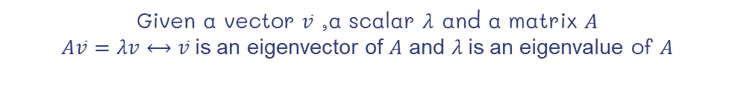
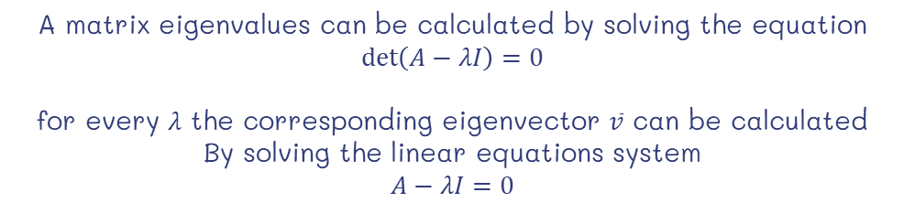
The Problem
Given a vector $\overline{v}$ ,a scalar $λ$ and a matrix $A$
$A\overline{v}=λv⟷\overline{v}$is an eigenvector of $A$ and $λ$is an eigenvalue of $A$
A matrix eigenvalues can be calculated by solving the equation
$$\det\left(A−λI\right)=0$$
for every $λ$ the corresponding eigenvector $\overline{v}$ can be calculated
By solving the linear equations system
$$A−λI=0$$

Slide 4
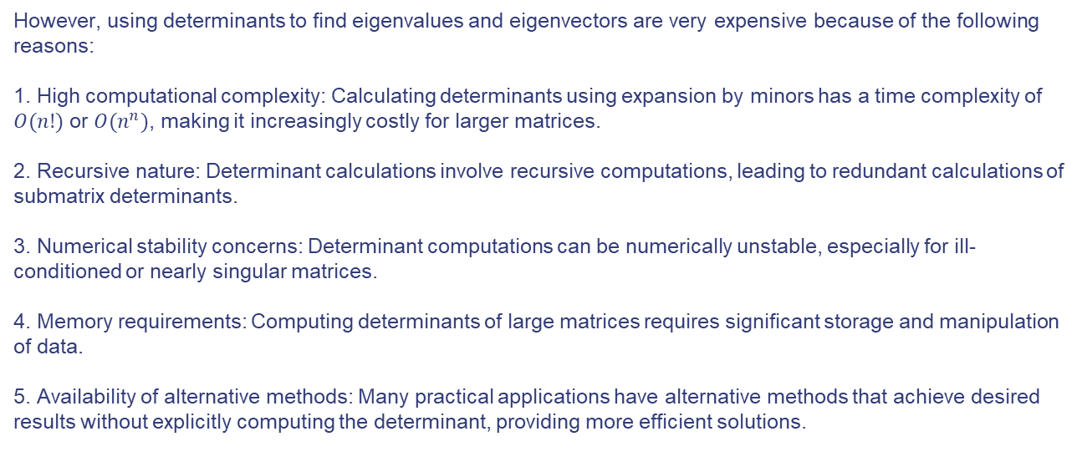
The Problem
However, using determinants to find eigenvalues and eigenvectors are very expensive because of the following reasons: 1. High computational complexity: Calculating determinants using expansion by minors has a time complexity of $O(n!)$ or $O(n^{n})$, making it increasingly costly for larger matrices.
2. Recursive nature: Determinant calculations involve recursive computations, leading to redundant calculations of submatrix determinants.
3. Numerical stability concerns: Determinant computations can be numerically unstable, especially for ill-conditioned or nearly singular matrices.
4. Memory requirements: Computing determinants of large matrices requires significant storage and manipulation of data.
5. Availability of alternative methods: Many practical applications have alternative methods that achieve desired results without explicitly computing the determinant, providing more efficient solutions.

Slide 5
The Solution
Given a real symmetric matrix $A$, use QR algorithm to find
eigenvalues and eigenvectors
There are 2 struggles with the following approach:
QR decomposition is computationally expensive
QR Convergence is not numerically stable.

Slide 6
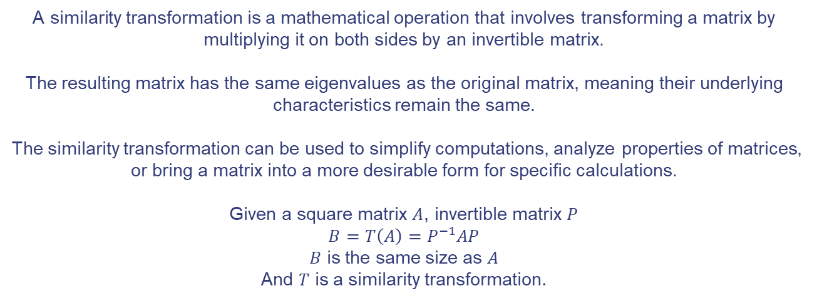
Similarity Transformation
A similarity transformation is a mathematical operation that involves transforming a matrix by multiplying it on both sides by an invertible matrix.
The resulting matrix has the same eigenvalues as the original matrix, meaning their underlying characteristics remain the same.
The similarity transformation can be used to simplify computations, analyze properties of matrices, or bring a matrix into a more desirable form for specific calculations.
Given a square matrix $A$, invertible matrix $P$
$$B=T\left(A\right)=P^{−1}AP$$
$B$ is the same size as $A$
And $T$ is a similarity transformation.

Slide 7
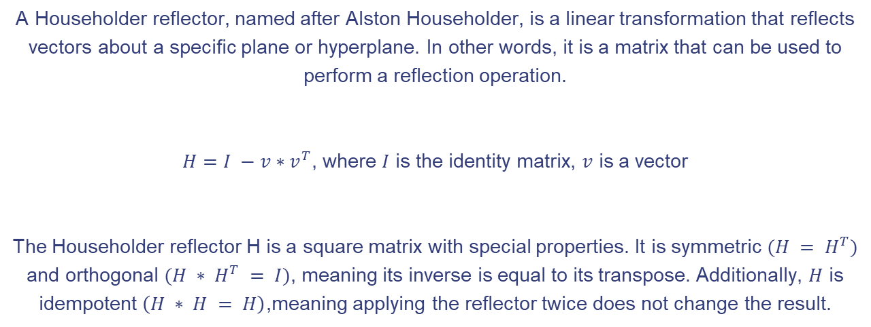
Householder Reflector
A Householder reflector, named after Alston Householder, is a linear transformation that reflects vectors about a specific plane or hyperplane. In other words, it is a matrix that can be used to perform a reflection operation.
$H=I −v∗v^{T}$, where $I$ is the identity matrix, $v$ is a vector
The Householder reflector H is a square matrix with special properties. It is symmetric $(H = H^{T})$ and orthogonal $(H ∗ H^{T} = I)$, meaning its inverse is equal to its transpose. Additionally, $H$ is idempotent $\left(H ∗ H = H\right)$,meaning applying the reflector twice does not change the result.

Slide 8
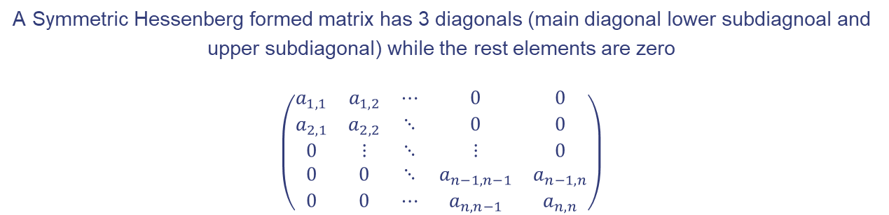
Hessenberg Form
To find a resolution for the computational complexity of QR convergence, we would like a way to recursively split our matrix, in order to do that the matrix needs to be Tri-diagonalized into Hessenberg Form
A Symmetric Hessenberg formed matrix has 3 diagonals (main diagonal lower subdiagnoal and upper subdiagonal) while the rest elements are zero
$$\left(\begin{matrix}a_{1,1} & a_{1,2} & ⋯ & 0 & 0 \\ a_{2,1} & a_{2,2} & ⋱ & 0 & 0 \\ 0 & ⋮ & ⋱ & ⋮ & 0 \\ 0 & 0 & ⋱ & a_{n−1,n−1} & a_{n−1,n} \\ 0 & 0 & ⋯ & a_{n,n−1} & a_{n,n}\end{matrix}\right)$$

Slide 9
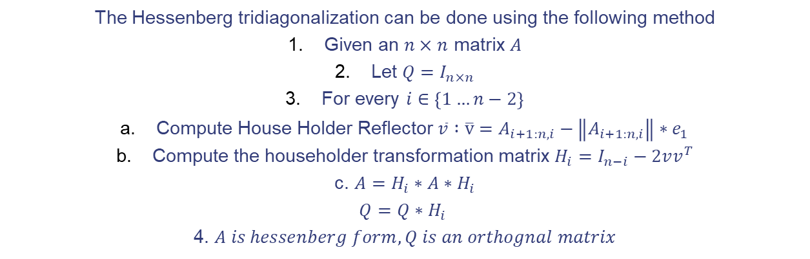
Hessenberg Form
The Hessenberg tridiagonalization can be done using the following method
Given an $n×n$ matrix $A$
Let $Q=I_{n×n}$
For every $i∈\left\{1…n−2\right\}$
Compute House Holder Reflector $\overline{v} :\overline{v}=A_{i+1:n,i}−\left\|A_{i+1:n,i}\right\|∗e_{1}$
Compute the householder transformation matrix $H_{i}=I_{n−i}−2vv^{T}$
c. $A=H_{i}∗A∗H_{i}$ $$Q=Q∗H_{i}$$
4. $A is hessenberg form, Q is an orthognal matrix$

Slide 10
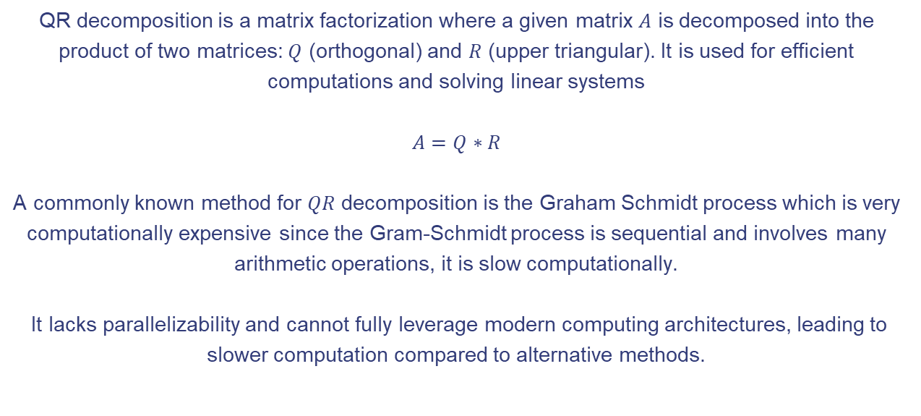
QR Decomposition
QR decomposition is a matrix factorization where a given matrix $A$ is decomposed into the product of two matrices: $Q$ (orthogonal) and $R$ (upper triangular). It is used for efficient computations and solving linear systems
$$A=Q∗R$$
A commonly known method for $QR$ decomposition is the Graham Schmidt process which is very computationally expensive since the Gram-Schmidt process is sequential and involves many arithmetic operations, it is slow computationally.
It lacks parallelizability and cannot fully leverage modern computing architectures, leading to slower computation compared to alternative methods.

Slide 11
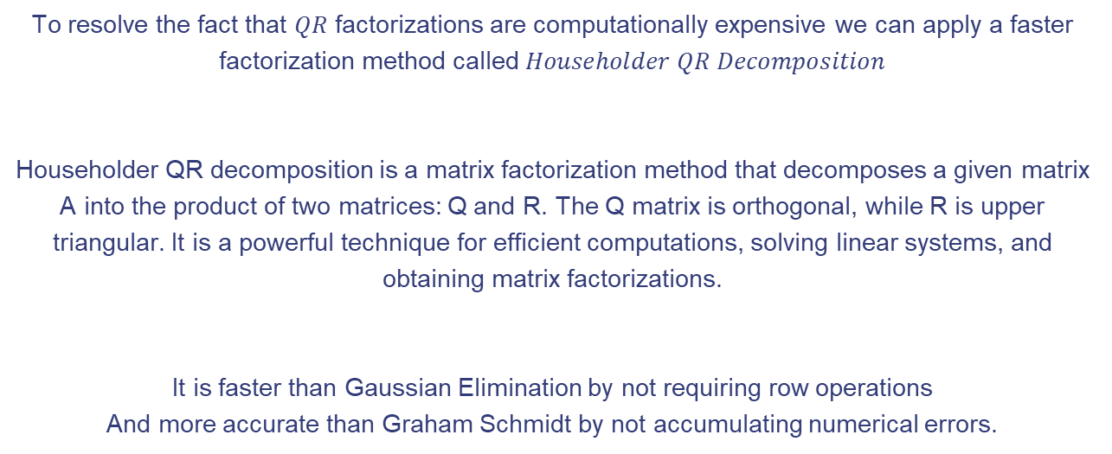
Householder QR Decompositon
To resolve the fact that $QR$ factorizations are computationally expensive we can apply a faster factorization method called $Householder QR Decomposition$
Householder QR decomposition is a matrix factorization method that decomposes a given matrix A into the product of two matrices: Q and R. The Q matrix is orthogonal, while R is upper triangular. It is a powerful technique for efficient computations, solving linear systems, and obtaining matrix factorizations.
It is faster than Gaussian Elimination by not requiring row operations
And more accurate than Graham Schmidt by not accumulating numerical errors.

Slide 12
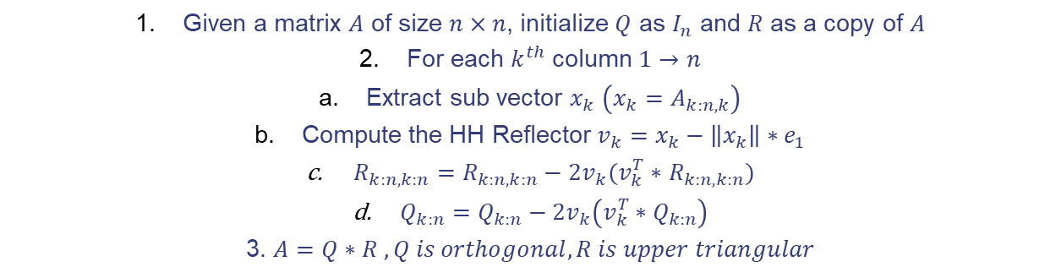
HH Decomposition Process
Given a matrix $A$ of size $n×n$, initialize $Q$ as $I_{n}$ and $R$ as a copy of $A$
For each $k^{th}$ column $1→n$
Extract sub vector $x_{k}$ $\left(x_{k}=A_{k:n,k}\right)$
Compute the HH Reflector $v_{k}=x_{k}−\left\|x_{k}\right\|∗e_{1}$
$R_{k:n,k:n}=R_{k:n,k:n}−2v_{k}(v_{k}^{T}∗$ $R_{k:n,k:n})$
$Q_{k:n}=Q_{k:n}−2v_{k}\left(v_{k}^{T}∗Q_{k:n}\right)$
3. $A=Q∗R , Q is orthogonal, R is upper triangular$

Slide 13
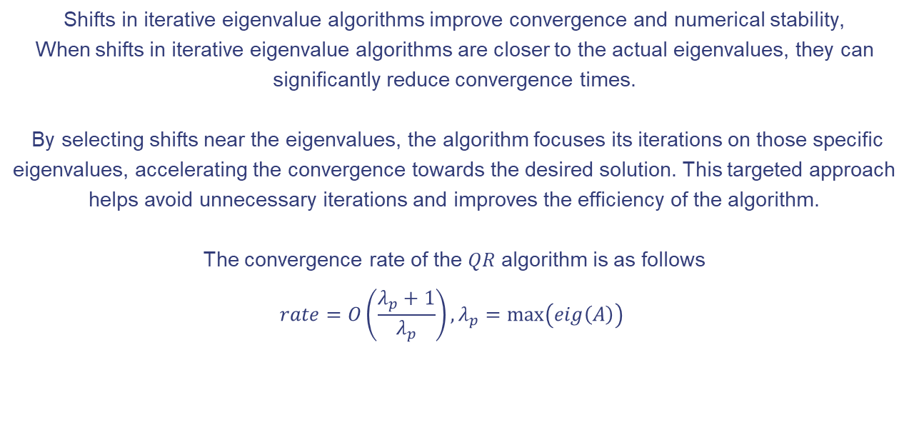
Wilkinson Shift
Shifts in iterative eigenvalue algorithms improve convergence and numerical stability, When shifts in iterative eigenvalue algorithms are closer to the actual eigenvalues, they can significantly reduce convergence times.
By selecting shifts near the eigenvalues, the algorithm focuses its iterations on those specific eigenvalues, accelerating the convergence towards the desired solution. This targeted approach helps avoid unnecessary iterations and improves the efficiency of the algorithm.
The convergence rate of the $QR$ algorithm is as follows
$$rate=O\left(\frac{λ_{p}+1}{λ_{p}}\right), λ_{p}=\max\left(eig\left(A\right)\right)$$

Slide 14
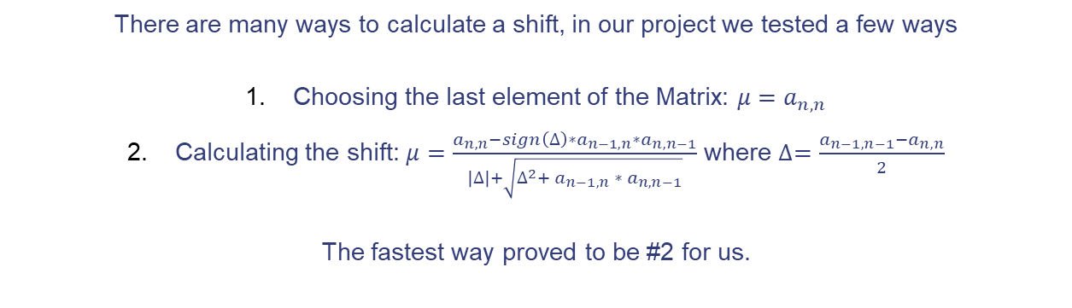
Wilkinson Shift
There are many ways to calculate a shift, in our project we tested a few ways
Choosing the last element of the Matrix: $μ=a_{n,n}$
Calculating the shift: $μ=\frac{a_{n,n}−sign\left(∆\right)∗a_{n−1,n}∗a_{n,n−1}}{\left|∆\right|+\sqrt{∆^{2}+ a_{n−1,n }∗{ a}_{n,n−1}}}$ where $∆=\frac{a_{n−1,n−1}−a_{n,n}}{2}$
The fastest way proved to be #2 for us.

Slide 15
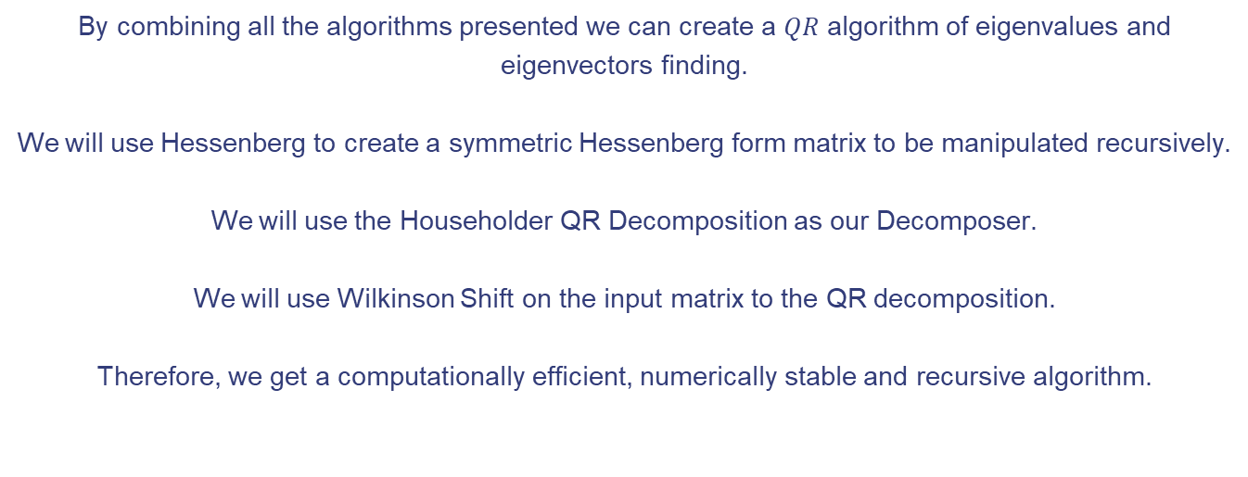
QR Convergence
By combining all the algorithms presented we can create a $QR$ algorithm of eigenvalues and eigenvectors finding.
We will use Hessenberg to create a symmetric Hessenberg form matrix to be manipulated recursively.
We will use the Householder QR Decomposition as our Decomposer.
We will use Wilkinson Shift on the input matrix to the QR decomposition.
Therefore, we get a computationally efficient, numerically stable and recursive algorithm.

Slide 16
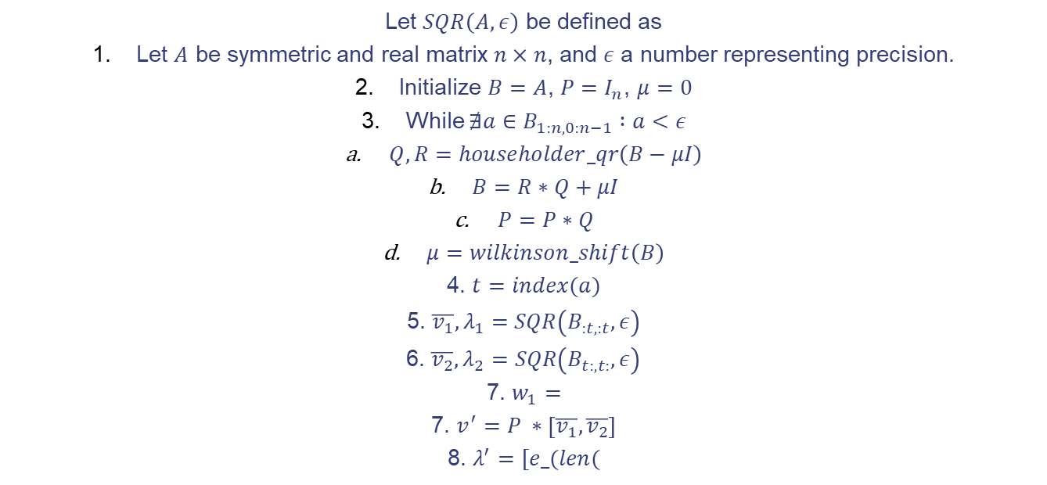
The Algorithm
Let $SQR\left(A, ε\right)$ be defined as
Let $A$ be symmetric and real matrix $n×n$, and $ε$ a number representing precision.
Initialize $B=A$, $P=I_{n}$, $μ=0$
While $∄a∈B_{1:n,0:n−1} :a<ε$
$Q,R=householder_qr\left(B−μI\right)$
$B=R∗Q+μI$
$P=P∗Q$
$μ=wilkinson_shift\left(B\right)$
4. $t=index(a)$
5. $\overline{v_{1}},λ_{1}=SQR\left(B_{:t,:t}, ε\right)$
6. $\overline{v_{2}},λ_{2}=SQR\left(B_{t:,t:},ε\right)$
7. $w_{1}=$
7. $v^{′}=P ∗\left[\overline{v_{1}},\overline{v_{2}}\right]$
8. $λ^{′}=[e_(len($

Slide 17
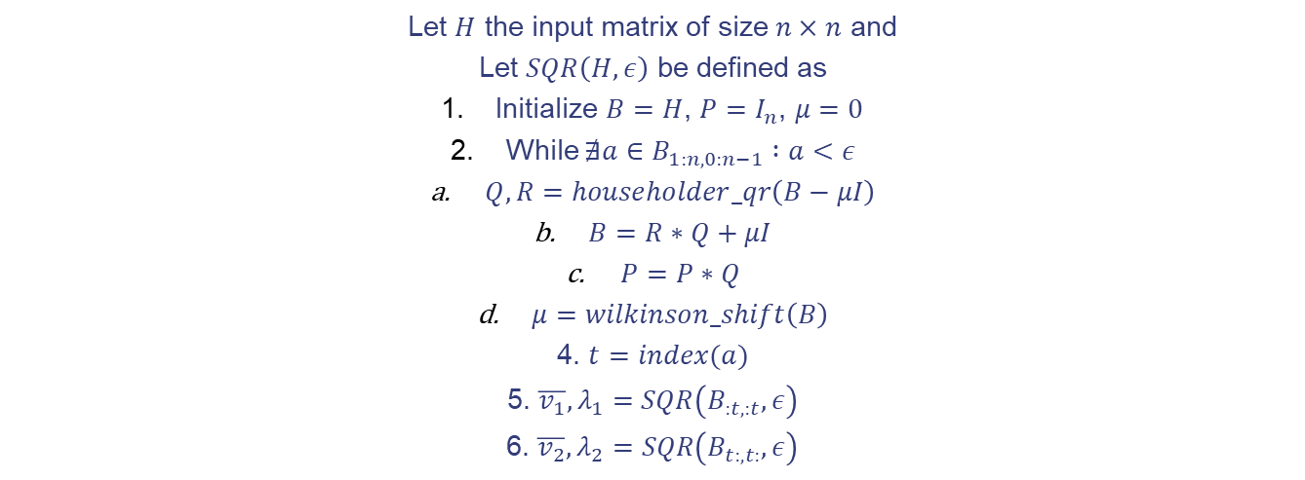
The Algorithm
Let $H$ the input matrix of size $n×n$ and
Let $SQR\left(H, ε\right)$ be defined as
Initialize $B=H$, $P=I_{n}$, $μ=0$
While $∄a∈B_{1:n,0:n−1} :a<ε$
$Q,R=householder_qr\left(B−μI\right)$
$B=R∗Q+μI$
$P=P∗Q$
$μ=wilkinson_shift\left(B\right)$
4. $t=index(a)$
5. $\overline{v_{1}},λ_{1}=SQR\left(B_{:t,:t}, ε\right)$
6. $\overline{v_{2}},λ_{2}=SQR\left(B_{t:,t:},ε\right)$

Slide 18
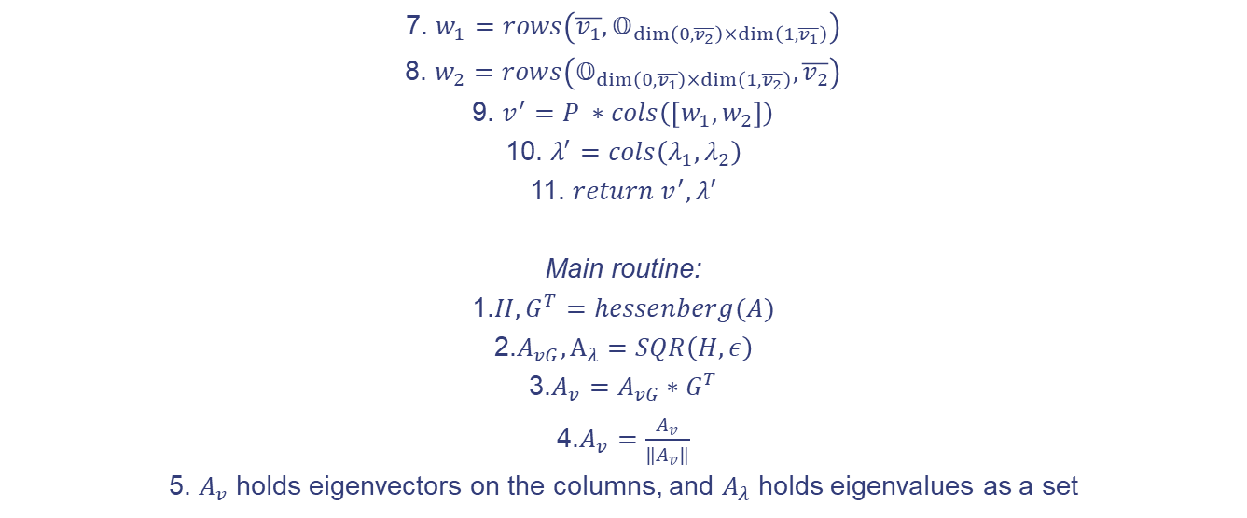
The Algorithm
7. $w_{1}=rows\left(\overline{v_{1}},𝕆_{\dim\left(0,\overline{v_{2}}\right)×\dim\left(1,\overline{v_{1}}\right)}\right)$
8. $w_{2}=rows\left(𝕆_{\dim\left(0,\overline{v_{1}}\right)×\dim\left(1,\overline{v_{2}}\right)}, \overline{v_{2}}\right)$
9. $v^{′}=P ∗cols\left(\left[w_{1},w_{2}\right]\right)$
10. $λ^{′}=cols\left(λ_{1},λ_{2}\right)$
11. $return v^{′},λ′$
Main routine:
1.$H,G^{T}=hessenberg(A)$
2.$A_{vG}, A_{λ}=SQR\left(H,ε\right)$
3.$A_{v}=A_{vG}∗G^{T}$
4.$A_{v}=\frac{A_{v}}{‖A_{v}‖}$
5. $A_{v}$ holds eigenvectors on the columns, and $A_{λ}$ holds eigenvalues as a set

